Slide 1
Northwind Data project
By Aviv Uziel

Slide 2
Our main leading question:
How can Northwind increase its profits using data-driven decisions?

Slide 3


overview

Slide 4
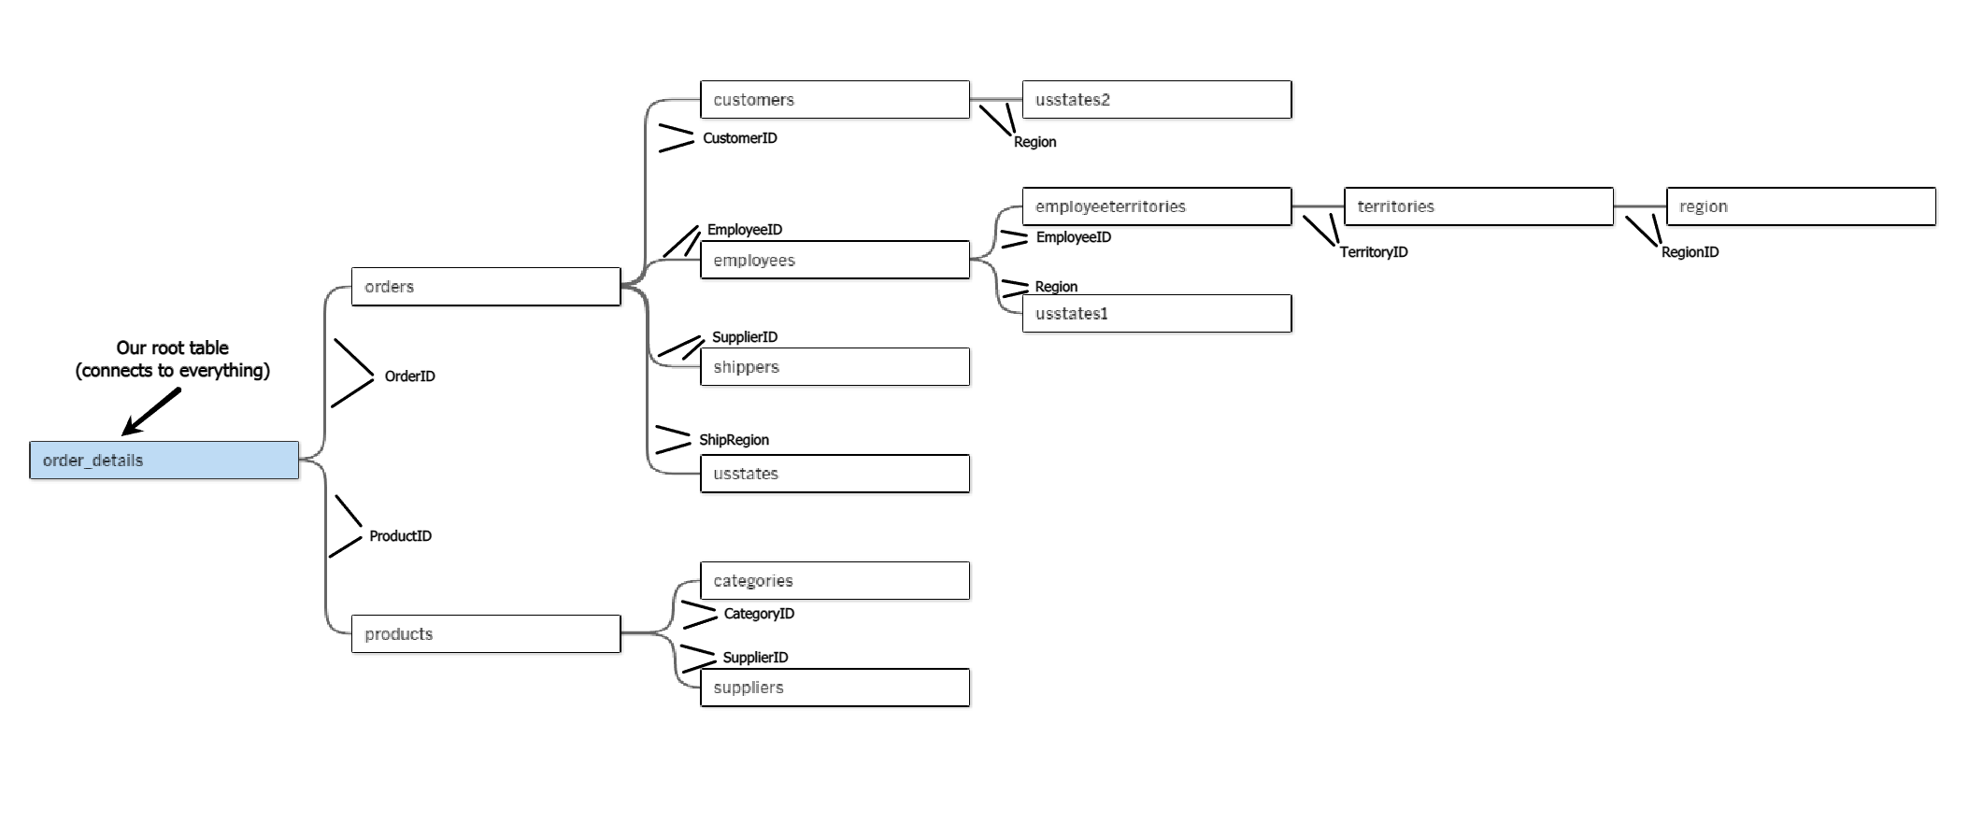
Our database
Northwind’s database is made of a total of 11 tables:

Slide 5




Some general metrics:
Northwind’s Data Range:
JULY/1996
MAY/1998
1.8 years
Total Revenue So Far
$541,109
Leading Countries By Revenue
Avg. Monthly Growth
8.5%
1. USA $105K
2. Germany $101K
3. Austria $53K
4. Brazil $45K
5. France $34K
Profit Margin
42.7%

Slide 6




For this project, we chose 3 main areas of focus:
Deliveries
locations
Product catalogue

Slide 7
Deliveries

Slide 8




Deliveries (1)
Avg. Delivery Time
8.5 DAYS
Shipping Companies Ranked By Avg. Delivery Time
1 Federal Shipping → ~7.5 DAYS
The Country With The Fastest Delivery Time:
Finland
2 Speedy Express → ~8.6 DAYS
3 United Package → ~9.2 DAYS
With an average of:
5.6 DAYS

Slide 9
Deliveries (2)
Bottom 10 Cities by Avg. Delivery Time
Late Deliveries % (Global)
Country | City | Late %
Brazil | Campinas | 33.3%
USA | Elgin | 20%
Germany | Leipzig | 20%
Italy | Torino | 16.7%
Ireland | Cork | 15.8%
USA | Seattle | 14.3%
Spain | Madrid | 12.5%
France | Marseille | 11.8%
Sweden | Luleו | 11.1%
USA | Lander | 11.1%

Slide 10
locations

Slide 11

Locations (1)
Bottom 5 Cities By Revenue
Leading Country By Revenue:
USA
Country | City | Revenue
USA | Walla Walla | $160
Canada | Vancouver | $226
Spain | Barcelona | $358
France | Reims | $594
Venezuela | Caracas | $606
Leading Country By Number Of Orders:
Brazil
* With a total of $1,944, Perhaps not worth our time
However, it’s ranked
4th
On Revenue

Slide 12


Locations (2)
Leading Cities By Revenue
Country Revenue Rank
USA 1
Brazil 2
Germany 3
Country | City | Revenue
Germany | Cunewalde | $49.1K
Austria | Graz | $44.6K
USA | Boise | $44K
Brazil | Rio de Janeiro | $23.6K
USA | Albuquerque | $21.8K
Ireland | Cork | $19.7K
UK | London | $17.3K
Brazil | Sao Paulo | $14.9K
Germany | Brandenburg | $14.4K
Sweden | Bracke | $12.8K
Favorite Product In These Countries:
Côtes de Blaye

Slide 13
Product Catalogue

Slide 14

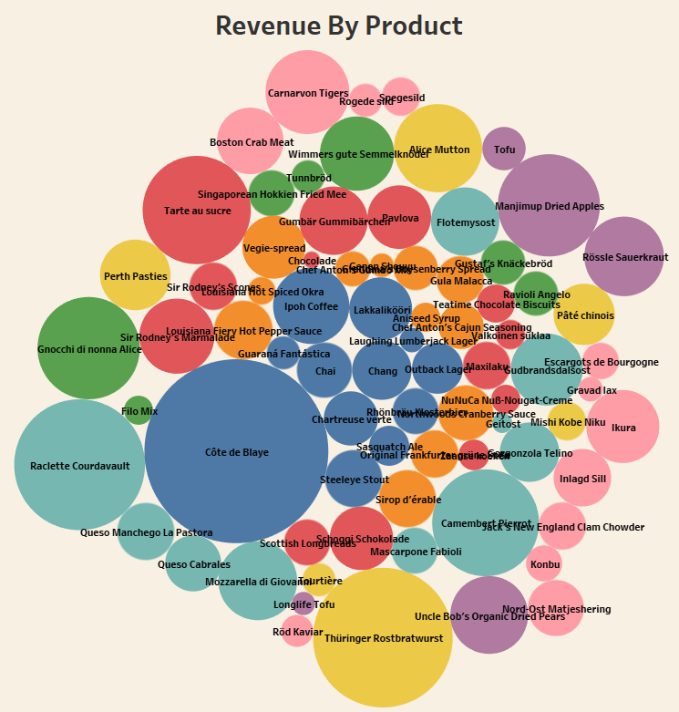
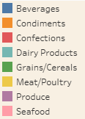

Product catalogue (1)
Leading Products By Revenue
1. Côtes de Blaye $59.3K
2. Thüringer Rostbratwurst $34.1K
3. Raclette Courdavault $30K
4. Tarte au Sucre $20.5K
5. Camembert Pierrot $20K

Slide 15
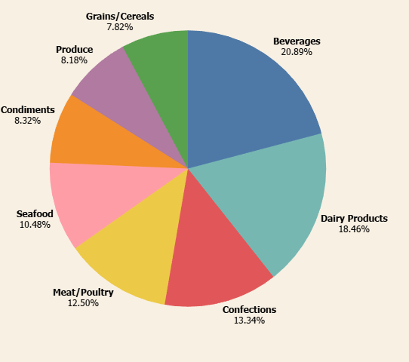
Product catalogue (2)
Product Categories By Revenue

Slide 16

Conclusions (1)
Deliveries:
“Federal Shipping” is the best company in terms of delivery time, let’s increase our deliveries with them when possible, On the other hand, try to decrease deliveries with “United Package”.
Focus on the 10 cities in the chart (Deliveries 2) - try to decrease delivery time in those cities. Moreover, we should look at all cities with a late delivery % of more than 5% (global average) and aspire to make them better in that regard.
Locations:
We should focus on the USA, as it’s clearly the biggest source of revenue.
Consider giving up deliveries, or perhaps increasing our marketing budget in the following cities: Walla Walla, Vancouver, Barcelona, Reims, Caracas
USA, Germany & Brazil, are some of our biggest revenue sources, their favorite product is “Côtes de Blaye”. We should aim to focus on this particular product and perhaps other similar products for them.

Slide 17
Conclusions (2)
Products:
Our most successful categories are Beverages & Dairy Products. we should be focusing on them in our marketing strategy and aim to add more products of these types.
Focus our marketing on our 5 leading products as their demand is very high.

Slide 18
THANK YOU
Made by Aviv Uziel

Slide 19

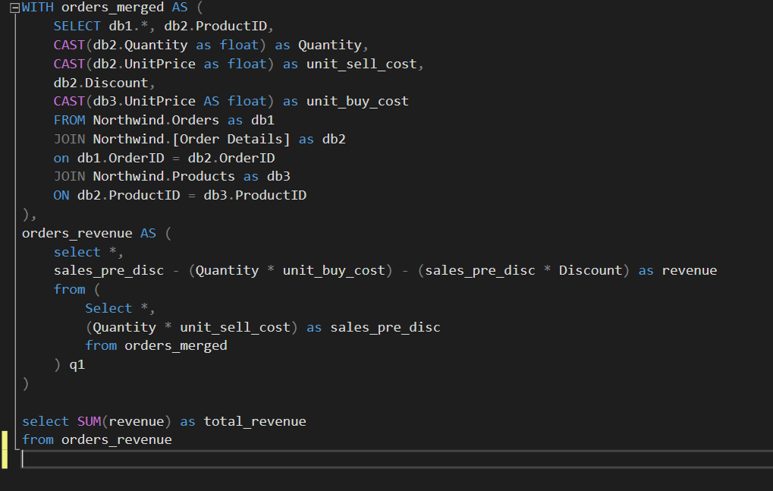
Overview (total revenue)
Appendix (1)

Slide 20
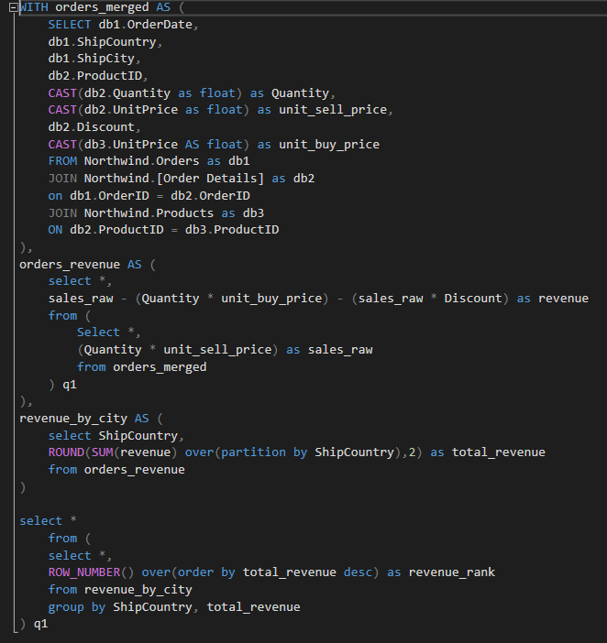
Overview (revenue by country)
Appendix (2)

Slide 21
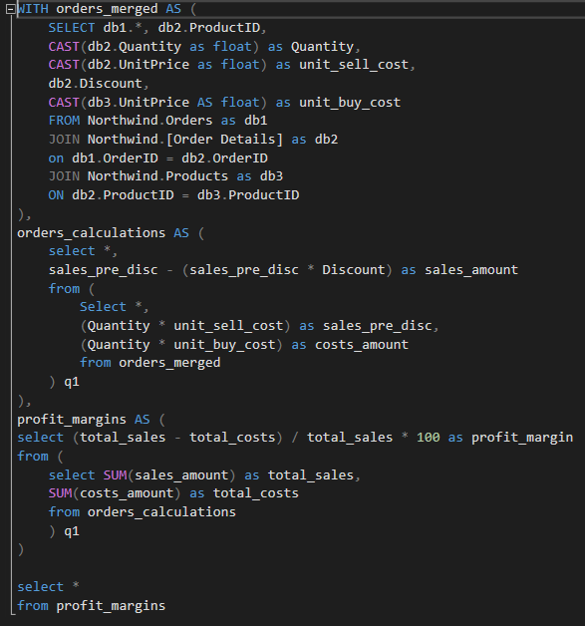
Overview (Profit margin)
Appendix (3)

Slide 22
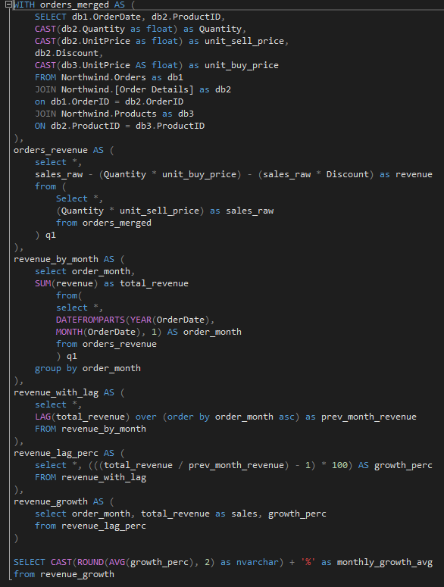
Overview (average monthly growth)
Appendix (4)

Slide 23
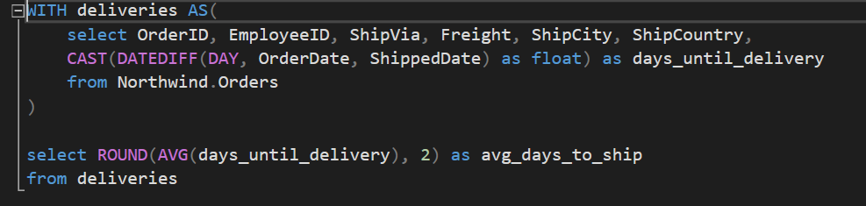
deliveries (average days to ship)
Appendix (5)

Slide 24
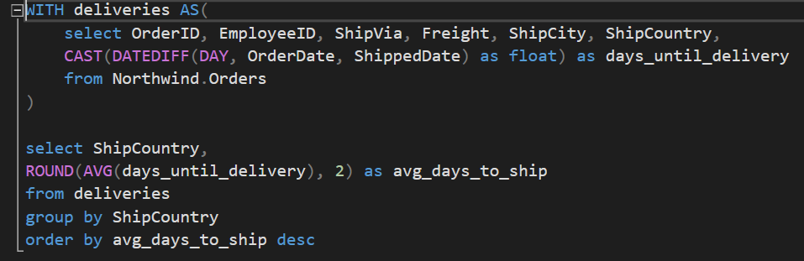
deliveries (average days to ship by country)
Appendix (6)

Slide 25
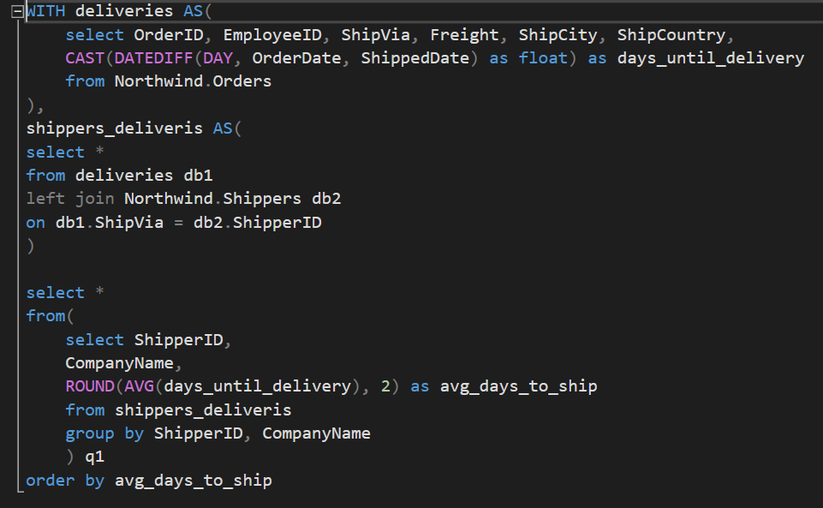
deliveries (average days to ship by Shipper)
Appendix (7)

Slide 26
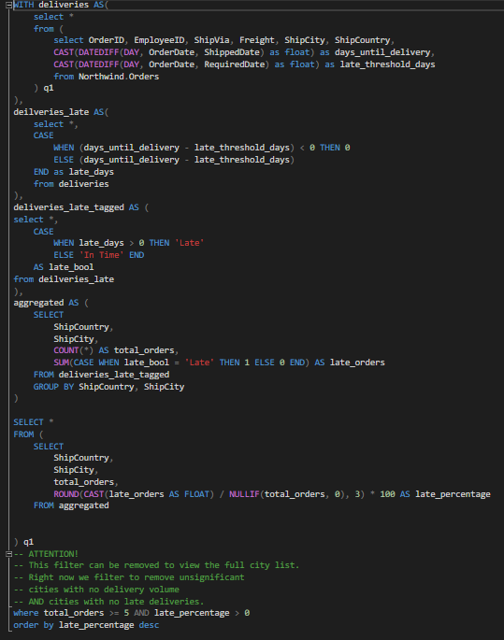
deliveries (Late % by city)
Appendix (8)

Slide 27
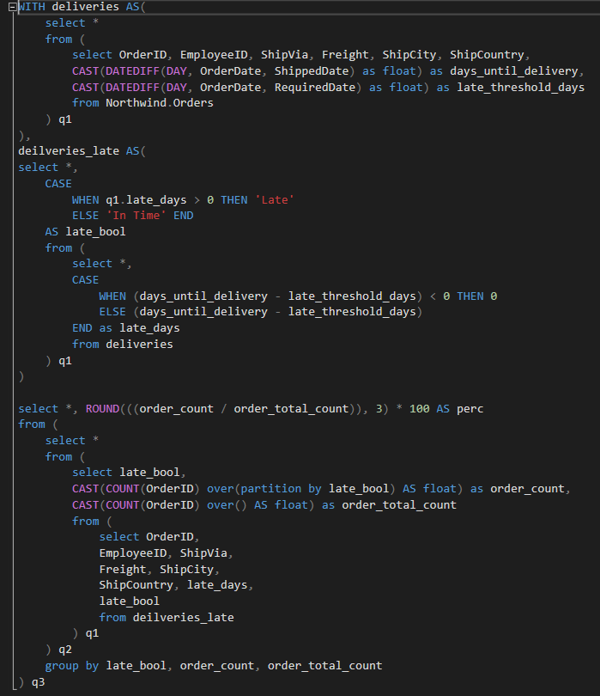
deliveries (Late % overall)
Appendix (9)

Slide 28
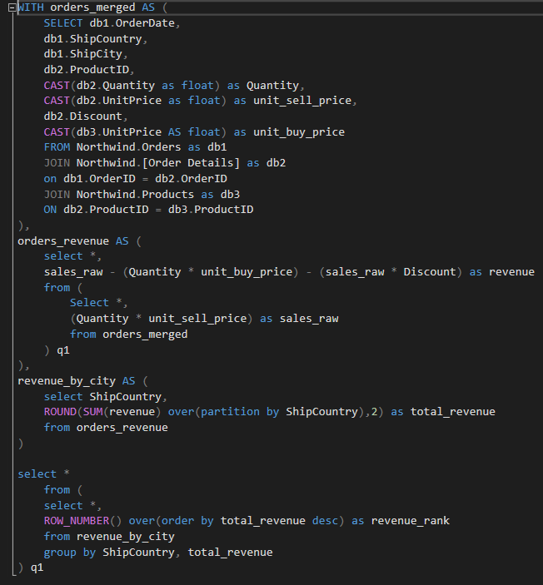
Locations (revenue by city)
Appendix (10)

Slide 29
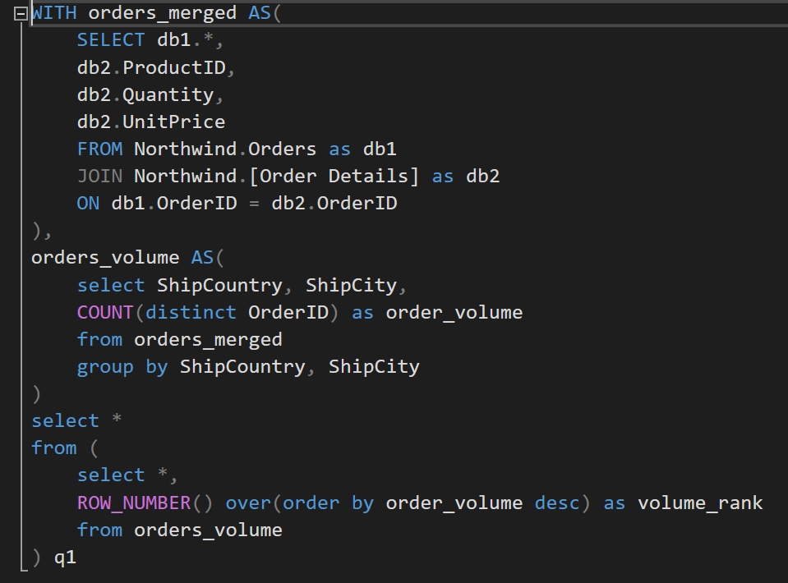
Locations (order count by country)
Appendix (11)

Slide 30
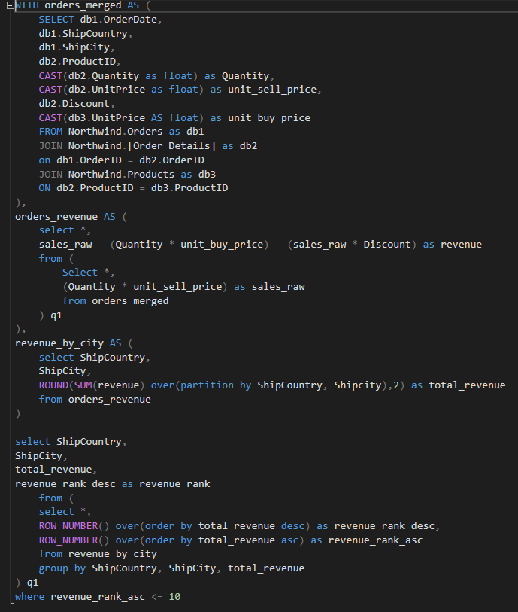
Locations (bottom 10 cities by revenue)
Appendix (12)

Slide 31
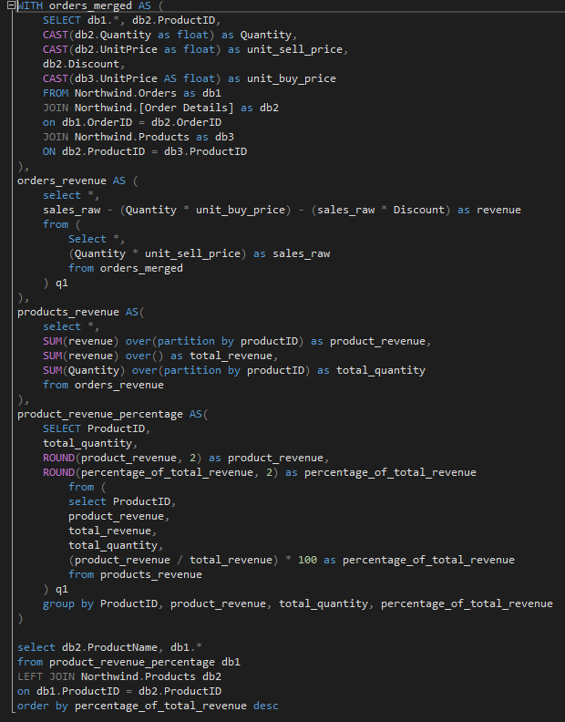
Product catalogue (revenue by product)
Appendix (13)

Slide 32
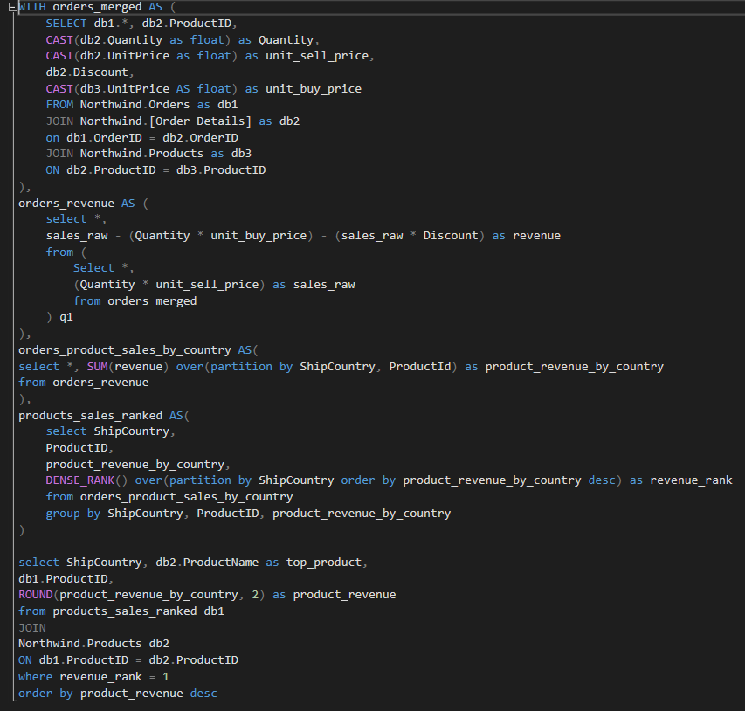
Product catalogue (most sold product by country)
Appendix (14)

